Slide 2


AMBASSADORS
AMBASSADOR MESSAGING - LYRICS ANALYSIS
AMBASSADOR MOOD - MUSIC PROPERTIES ANALYSIS
FACTORS FOR IDENTIFYING THE NEXT AMBASSADORS

Slide 3
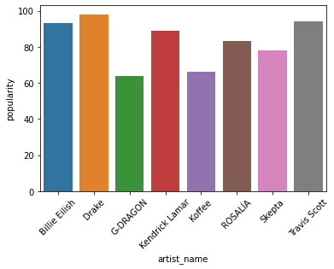
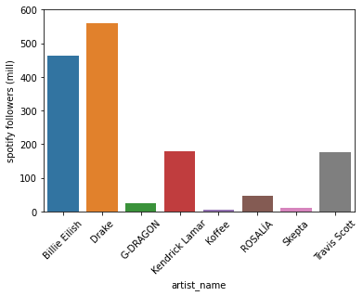
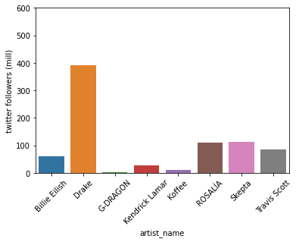
AMBASSADORS
FOLLOWING AND POPULARITY
Artist popularity on Spotify
Artist followers on Spotify
Artist followers on Twitter
Insights:
Artist popularity at any moment in time on spotify is not always aligned with the number of followers. This may indicate less commitment to this artist, and less marketing power.
Some artists have more followers on twitter, indicating a different type of fan potentially. For example, Skepta and Rosalia have bigger following on Twitter than on Spotify. And Billie Eilish and Drake have more followers on Spotify. One possibility would be Billie’s fans being younger, or possibly more female. We would have to dive deeper to be sure.
Key Takeaways:
We should measure the ROI on those current artist whose popularity is high now, but following is relatively low. Are they a good longer term investment?
We should dive deeper into the segments that we have: there are clear differences in the twitter / spotify activity for these artists fans. If we can get a closer look at the demographic, we can find out if we are targeting segment we intended with this artist
If we didn’t target a specific segment, then we can find out what segment they appeal to and if that is a segment we want to grow in or not.

Slide 4
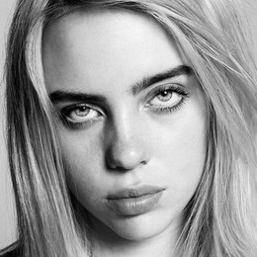
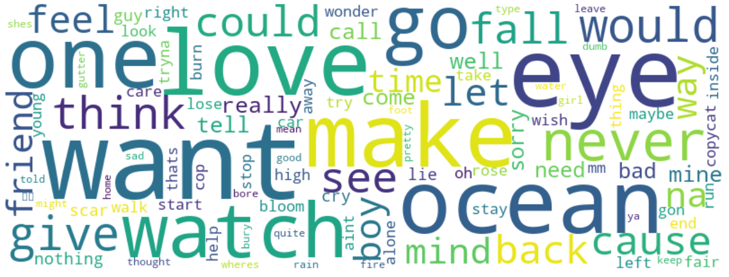
AMBASSADORS
TEXT ANALYSIS
Billie Eilish
Topic interpretation
Feeling left alone, lost
Strong, assertive, defensive
Love, beauty
Sentiment**
Avg = 0.08
Min: -0.8. | Max: 0.7
Commonly used phrases
“Give me those ocean”
“High falling into your”
“Can not say no”
“Watch your car burn”
**Sentiment is a measure of whether the text expresses a positive, negative, or neutral sentiment. +1 is positive and -1 is negative

Slide 5
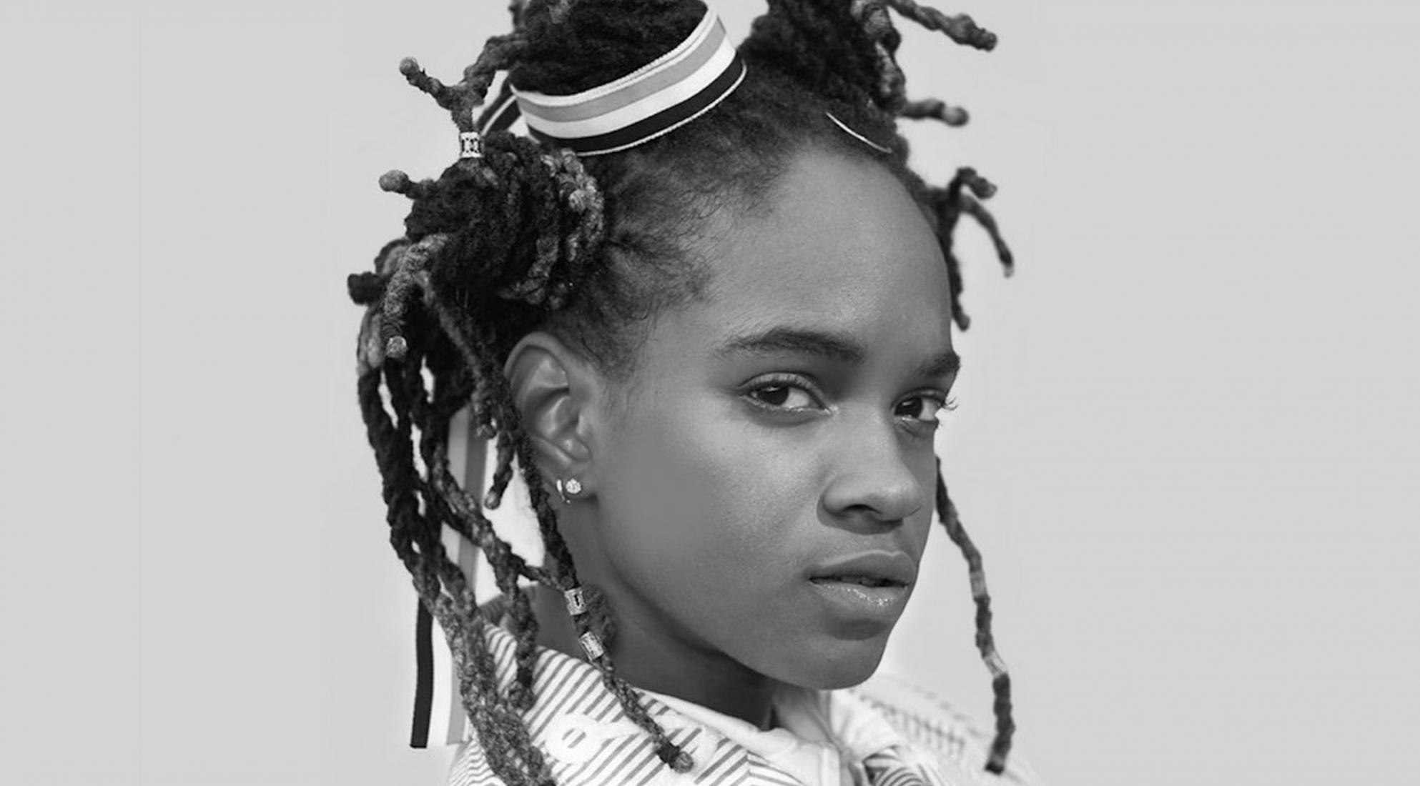
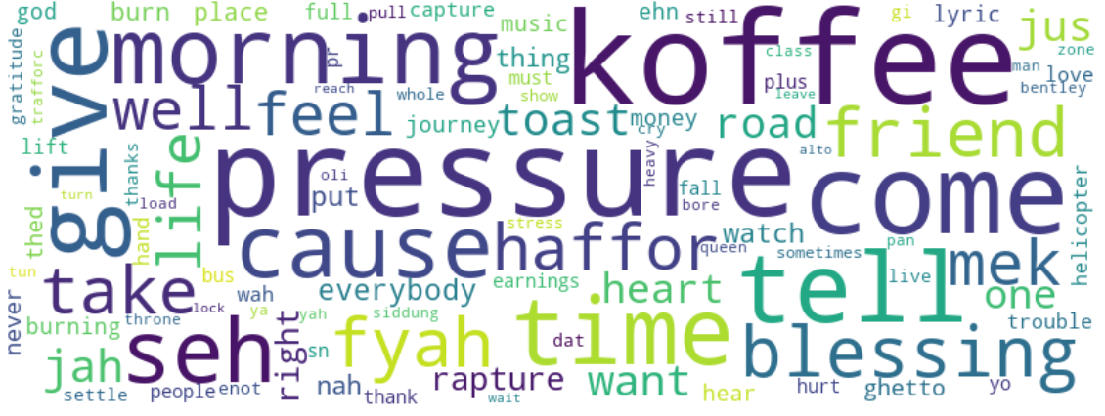
AMBASSADORS
TEXT ANALYSIS
Koffee
Topic interpretation
Caring, help in trouble times
Having money, status symbols
Blessings and gratitude
Sentiment**
Average 0.145
Min -0.03 | Max 0.38
Commonly used phrases
“queen_the_on_the_throne”
“jus_for_the_plus”
“journey_the_earnings”
“full_of_love”
**Sentiment is a measure of whether the text expresses a positive, negative, or neutral sentiment. +1 is positive and -1 is negative

Slide 6
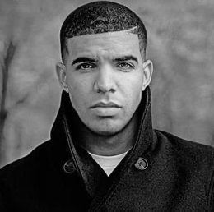
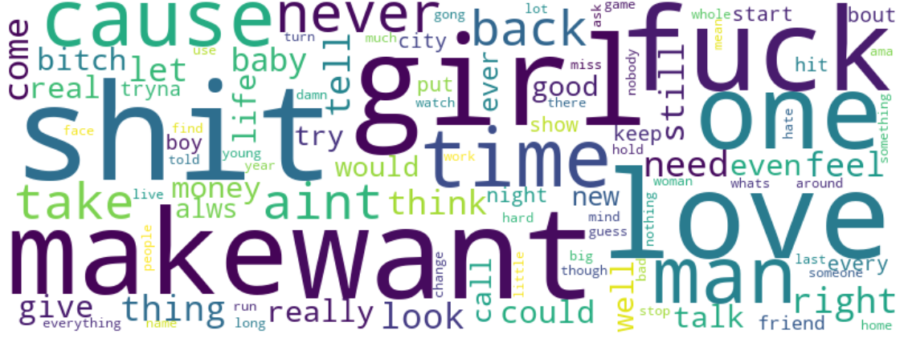
AMBASSADORS
TEXT ANALYSIS
Drake
Topic interpretation
Love, feelings, relationship
Loss
sentiment**
Average 0.05
Min -0.432| Max 0.49
Commonly used phrases
“dance to the song”
“sitting on the bench”
“started from the bottom”
“Heat of the moment”
* IMPORTANT: By far the MOST common word was the n-word, which I didn’t want to include here. However I think it is important to take into consideration. It was used 951 times in all these songs, while the next most common word ‘fuck’ was used 773 times.
**Sentiment is a measure of whether the text expresses a positive, negative, or neutral sentiment. +1 is positive and -1 is negative

Slide 7
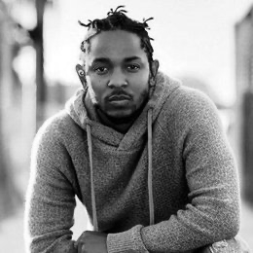
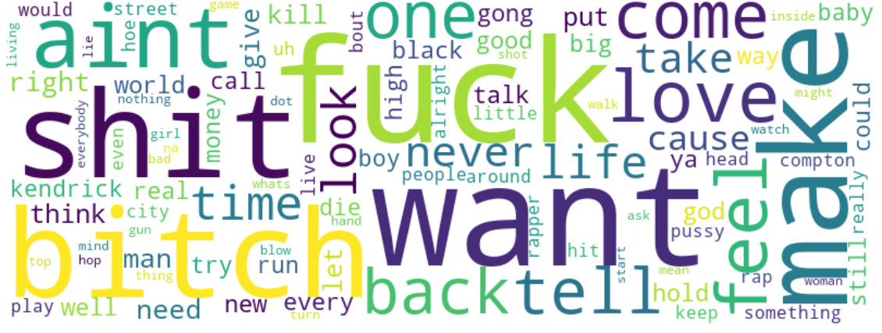
AMBASSADORS
TEXT ANALYSIS
Kendrick Lamar
Topic interpretation
Kill, money, defensiveness
Drugs, drink, sex
Love, world
Sentiment**
Average 0.042
Min -0.36. | Max 0.358
Commonly used phrases
“we_gong_be_alright”
“loving_you_is_complicated”
“women_weed_and_weather”
“pool_full_of_liquor”
* IMPORTANT: By far the MOST common word was the n-word, which I didn’t want to include here. However I think it is important to take into consideration. It was used 1282 times in all these songs, while the next most common word ‘fuck’ was used 769 times.
**Sentiment is a measure of whether the text expresses a positive, negative, or neutral sentiment. +1 is positive and -1 is negative

Slide 8
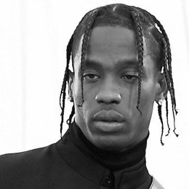
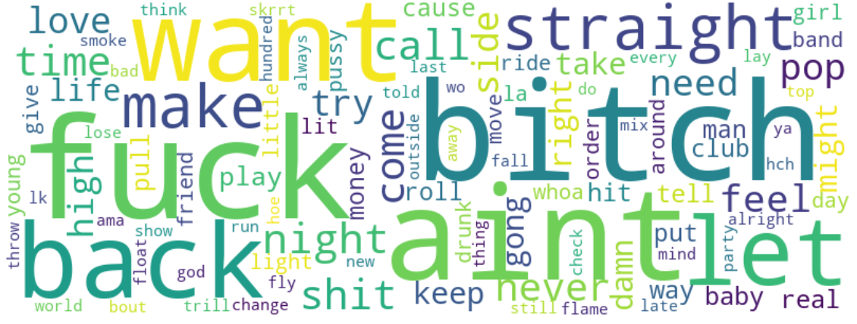
AMBASSADORS
TEXT ANALYSIS
Travis Scott
Topic interpretation
Club, band, music
Drugs, sex
Drink, smoke
Sentiment**
Average 0.036
Min -0.4 | Max. 0.69
Commonly used phrases
“ice_on_in_the_bath”
“hoes_and_the_alcol”
“breakfast_on_a_jet”
“wine_and_a_hennessy”
* IMPORTANT: By far the MOST common word was the n-word, which I didn’t want to include here. However I think it is important to take into consideration. It was used 1005 times in all these songs, while the next most common word ‘fuck’ was used 506 times.
**Sentiment is a measure of whether the text expresses a positive, negative, or neutral sentiment. +1 is positive and -1 is negative

Slide 9
AMBASSADORS
INSIGHTS AND TAKEAWAYS (text analysis)
Nike values: Diversity and Inclusion
At Nike, we believe in the power of people to move the world forward. Our mission is to be a leader in building a diverse, inclusive team and culture.
Nike values: Building communities
We build community through our shared love of sport, and it all begins with the next generation. Our approach focuses on building more equal, inclusive and active communities; investing in the areas where we live and work; and engaging our employees in their communities.
MESSAGE
Kendrick Lamar and Travis Scott project a message of mysoginy and objectifying women in their lyrics, and portraying men as macho, drinking and using drugs, referring to killing and aggression. This is not in line with nike Diversity and Inclusion messaging around gender and sexuality specifically.
Koffee, although less popular, is much more inspiring in her lyrics. She refers to female empowerment, love and gratitude. This is much more in line with Nike messaging. She is a black woman as well and Nike connecting with her displays commitment to D&I for her fans.
SETIMENT
Measured sentiment show that Koffee and Billie convey positive and even inspiring feelings in their lyrics. The positive sentiment is more in line with Nike values.
Drake is somewhat less, and Kendrick and Travis are lower, conveying negative feelings in their lyrics.

Slide 10
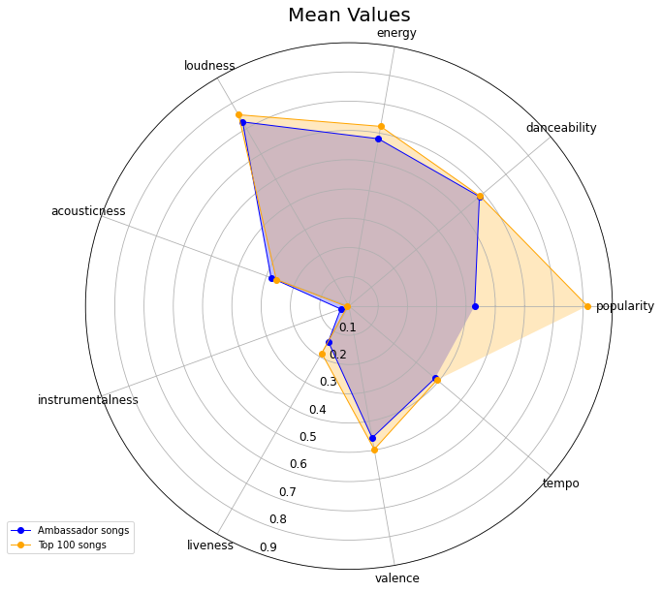
AMBASSADORS
AUDIO FEATURE COMPARISON
Comparison of ambassador song properties against the top 100 from Spotify:
Ambassadors songs are significantly less popular that the top 100
Ambassadors have slightly higher loudness, energy and valence
What does that tell us?
Our ambassadors are not the most popular artists on spotify. It can mean that we feel our customers like somewhat less popular musicians.
It could also indicate that there are a lot of music fans out there that we are not reaching with our current ambassadors. We could be using ambassadors that appeal to a narrower age group, or more to male than female customers.
Opportunities:
Analyze the listeners for the top 100 songs and compare age group, gender split and genre with Nike users.
Find ambassadors who may appeal more to this group.

Slide 11
AMBASSADORS
FACTORS FOR IDENTIFYING NEXT AMBASSADORS
Use Machine Learning techniques to help you measure all of these factors
Gender
Increase the number of female Nike customers by contracting musicians which appeal more to them.
Up and coming musicians
Contracting the next big thing before it’s the next big thing
Age group
Our ambassadors appeal to the younger part of our market segment (millenials and gen-z), however they don’t appeal so much to older customers, above 40. There is an opportunity for nike to grow this segment.
What worked in the past? Measure and adapt….
Measure our ROI with existing ambassadors through certain metrics, and use that as feedback into our models for selecting new artists

Slide 12
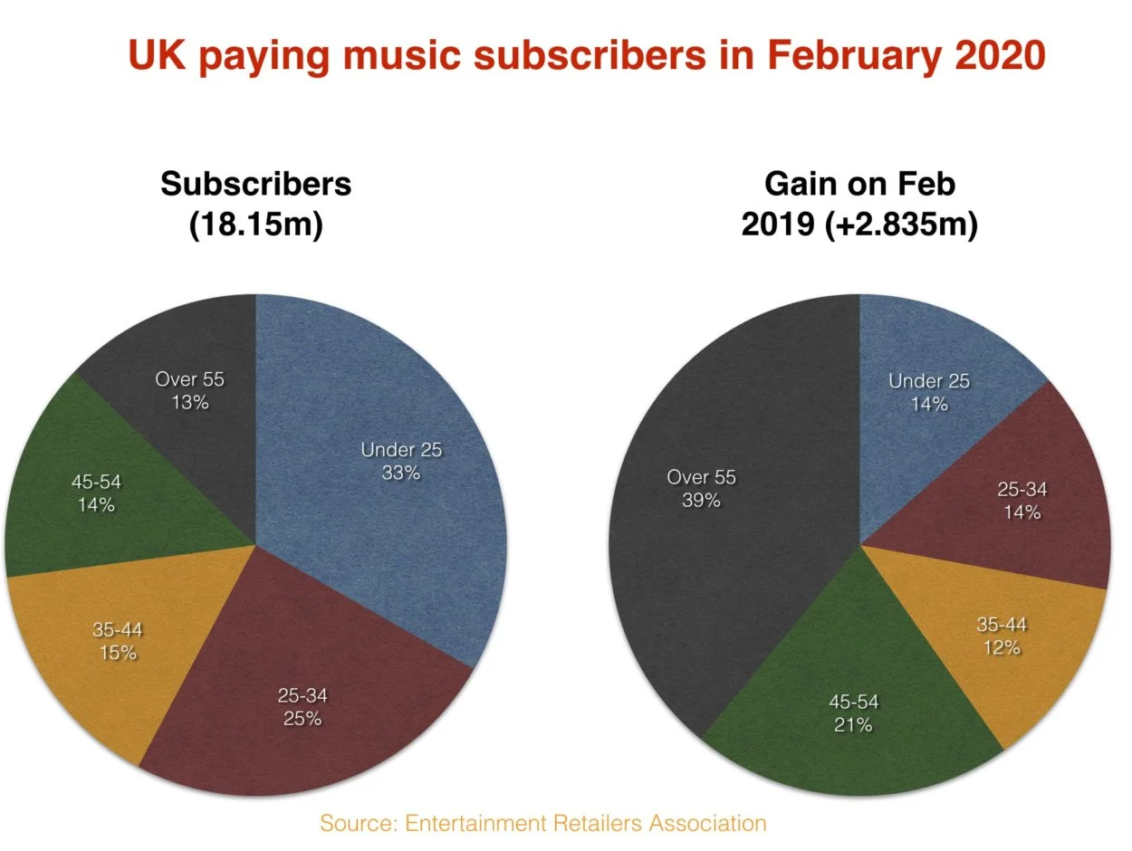
AMBASSADORS
AGE SEGMENT
According to previously published ERA stats, UK calendar year spending on music streaming subscriptions in 2019 reached £1.003bn ($1.28bn), up £190.9m on the prior year (£812m).
ERA’s latest data suggests that 60% of this growth came from people 45 or over.
Opportunity: 45+ age group
Nike’s current market segment is around 15 - 45
Ambassadors: dive into which artists the 45 plusers are listening to. Can we bring these artists into the fold to appeal to help grow our market in this segment?
https://www.musicbusinessworldwide.com/stat-of-the-week-people-over-45-not-millennials-are-driving-music-subscription-growth-in-the-uk/

Slide 13
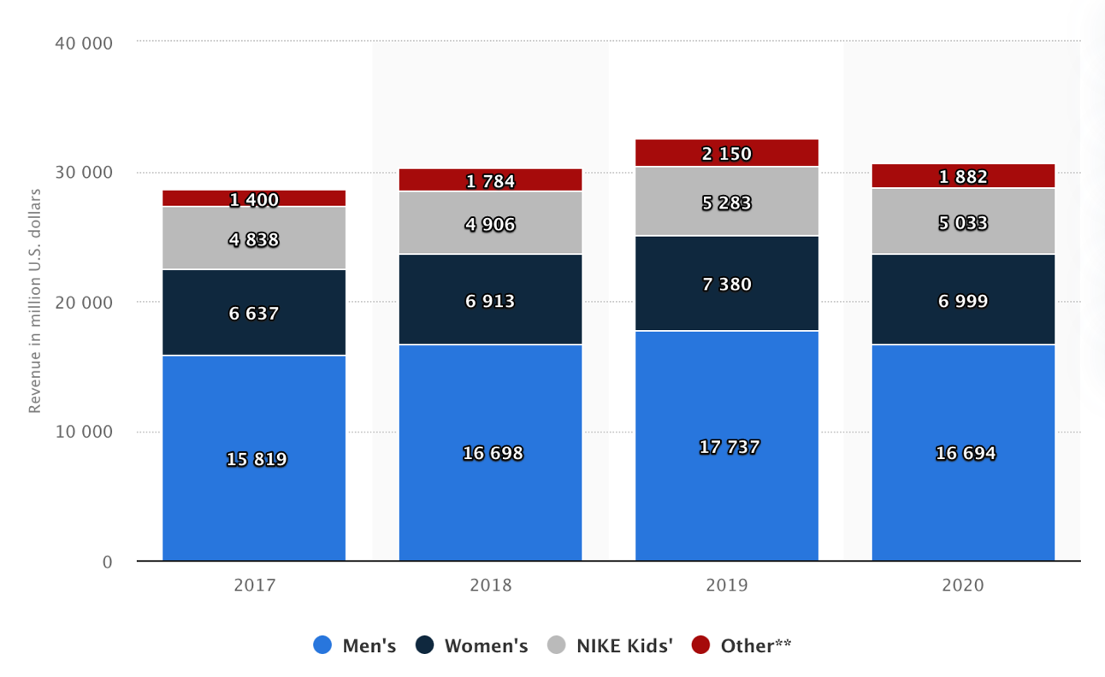
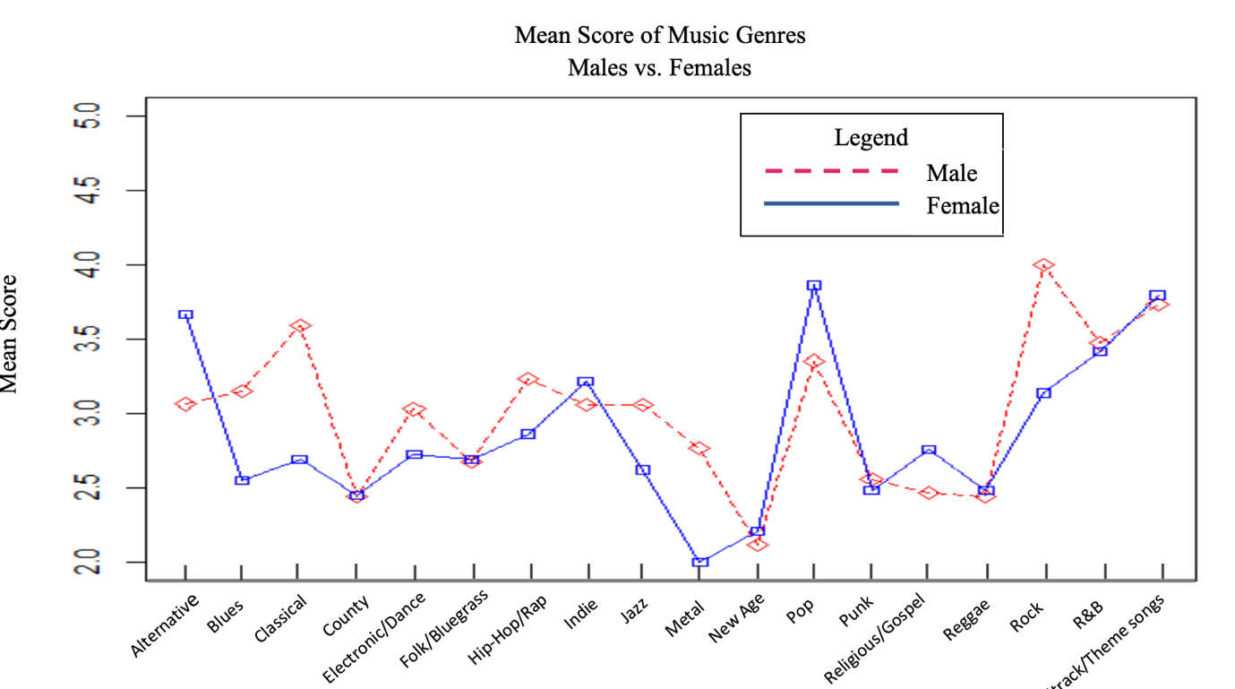
AMBASSADORS
GENDER & MUSIC
Opportunity: Women
One of Nike’s strategic focus areas is Women, and it has a lot of potential to grow:
GENRE
Hip-Hop has an average female gender balance of 32%
Our ambassadors are hip-hop focussed, so we are appealing to majority of men in that case
(https://deezer.io/women-hip-hop-e00fb19cc885)
Engage more women by partnering with alternative or pop musicians
We can dive into other audio features which might appeal more to women: Tempo, energy, mood; and again put all of these together using ML techniques to identify suitable musician influencers.
https://scholarcommons.sc.edu/cgi/viewcontent.cgi?article=1137&context=senior_theses

Slide 14
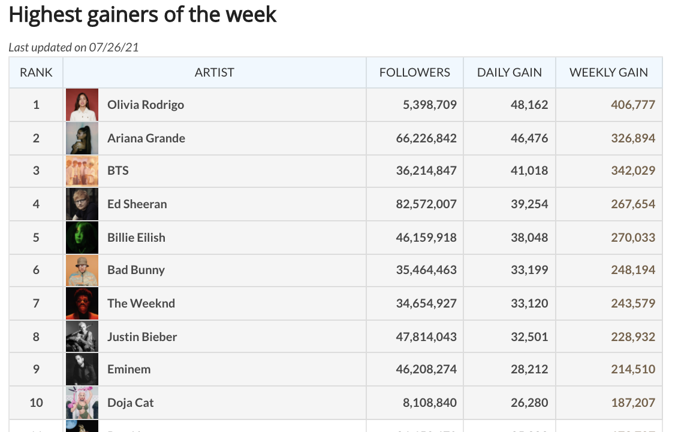
AMBASSADORS
UP AND COMING MUSICIANS
Opportunity:
partner with future stars before our competitors do
Associate Nike always with the latest music
Use data like we see here to identify the next Billie Eilish or Drake
We can track highest weekly gains on spotify, twitter, and other streaming services
Using machine learning, we can combine those statistics with other factors like genre, tempo, text analysis and other factors to identify which of these future stars is the best fit for Nike.
https://chartmasters.org/spotify-highest-gainers-in-followers/

